Slide 1
ADVICE FOR MUNICIPALITIES
ON HOW TO DEAL WITH
ELECTRONIC BILLBOARD LIGHTING ISSUES or
HOW TO PREVENT GLARING ERRORS
Pennsylvania Outdoor Lighting Council
A Pennsylvania Chapter of the International Dark Sky Assn

Slide 2
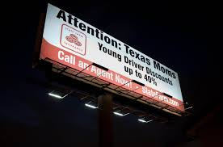
WHAT HAS CHANGED?
  Traditional billboards use external light sources, aimed up or down toward the sign face.
BOTTOM LIT BILLBOARD

Slide 3
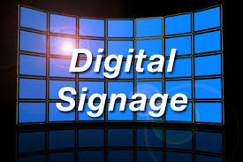
WHAT HAS CHANGED?
  LED billboards are back-lighted with the LEDs aimed out and down toward the viewer.
BACK LIT LED BILLBOARD

Slide 4
THE GOOD, THE BAD, THE UGLY

Slide 5
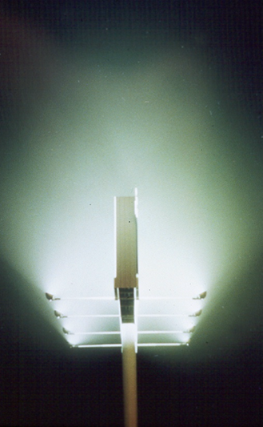
THE GOOD
LEDs have less power consumption
Brightness adjustable to accommodate changing ambient light levels and after hours dimming .
Have much longer light source life
Put less light into the sky
Contain no mercury or lead

Slide 6
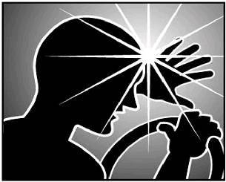
THE BAD
Typically excessively bright/glary
Moving message may promote driver distraction
Driver vision may be hampered after passing from bright sign into dark area
Light trespass into homes
  Potential residential property
  devaluation

Slide 7
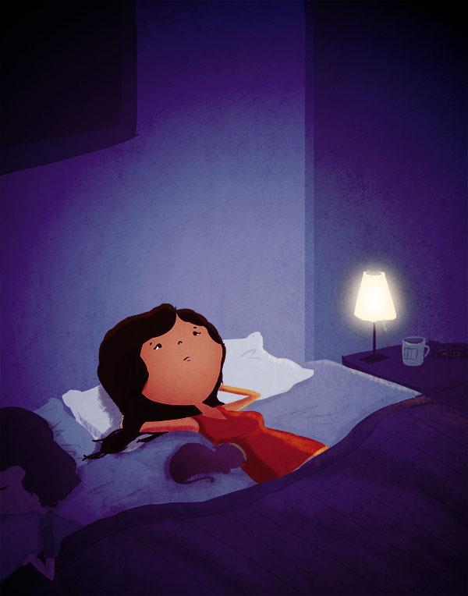
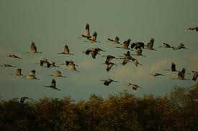


THE UGLY
Incessant on/off flashing in the night sky as message changes, causes annoyance, big time.
Flashing in bedroom window can disrupt sleep and impact health.
Negative impact on habitat of flora and fauna
and bird navigation

Slide 8
LIGHTING IMPACT LOCATION DEPENDENT
In commercial/industrial district with high ambient light level, potential billboard brightness impact may be minimal and require minimal regulation.
In or near residential district or within an area with low ambient lighting, billboard brightness impact can be intolerable and require strict regulation.

Slide 9
MINIMIZING THE UGLY
Control where billboards are permitted
  In which zoning districts
  On limited access roads, not at or near intersections, exit or entrance ramps or merging lanes
  Not where board face or flashing light visible from a residential use
Control minimum spacing between sign locations

Slide 10
MINIMIZING THE UGLY contd.
Control minimum duration of message
  Sign industry advocates 8 seconds
  Recommend 30 – 60 seconds depending upon location of board with respect to traffic speed
Control message change transition time
  Should be instant – no fade, blur or slide off.
  Require message to freeze in off mode in event of board malfunction.

Slide 11
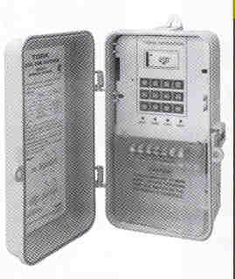
MINIMIZING THE UGLY
If in area sensitive to ambient light:
  Control maximum dimensions of board lighted area
  Control maximum day and night brightness
  Control time and degree of dimming
  Control if and when sign must be shut off nightly
  at close of business or in residential zone.

Slide 12
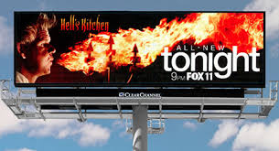
MINIMIZING THE UGLY contd.
Hold applicant responsible for demonstrating conformance with approved brightness values
Hold applicant responsible for post-installation brightness adjustment, if determined to be necessary.

Slide 13
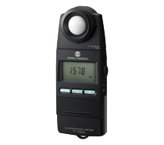
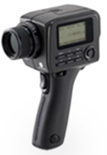
MEASURING SIGN BRIGHTNESS
What metric should be used in ordinance to measure and control sign-face brightness?
  Should ordinance use footcandles (illuminance)?
  Should ordinance use cd/m² [nits] (luminance) ?
Illuminance (Footcandle) Meter
Luminance 1 Degree Spot Meter

Slide 14
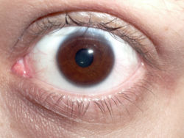
MEASURING SIGN BRIGHTNESS
Footcandles measure light received by the eye
  not only from sign face but also from surrounding light sources whose rays reach viewer’s eyes. Difficult to isolate just sign contribution.
  Footcandles vary inversely with the square of the distance from the sign to the viewer

Slide 15

MEASURING SIGN BRIGHTNESS
Nits (cd/m²) measure brightness on sign face
  Minimally influenced by surrounding light sources
  Distance from sign face not critical. Luminance does not vary with distance, only apparent size of source varies.
Luminance, rather than illuminance, is the better metric choice.

Slide 16
BRIGHTNESS LEVEL
When is enough too much?
  Acceptable brightness level is very much location dependent.
For ordinance, a good starting number would be
  5000 nits during daylight hours
  200 nits during hours of darkness
For application evaluation, thorough consideration of ambient conditions imperative, with appropriate brightness maximums imposed.

Slide 17
BRIGHTNESS VERIFICATION
Sign owner can promise but will it be delivered?
Sign owner can, with the press of a button, ratchet up sign brightness levels after installation.
How to verify applicant’s brightness commitment?
  “Brightness is in the eye of the beholder.” One person’s brightness is another’s disabling glare
  Will code officer’s subjective evaluation of sign brightness be acceptable? “Looks OK to me!”

Slide 18
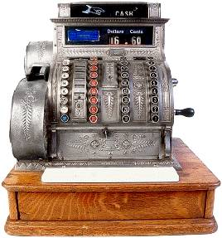
BRIGHTNESS VERIFICATION
Should municipality purchase a meter?
  Can municipality justify meter expenditure?
    Footcandle meters cost from $100 - $1000.
    Luminance meters cost $3000+.
    Meter NIST recalibration costs ± $500
    Large investment for occasional use

Slide 19
BRIGHTNESS VERIFICATION
  Suggested Solutions –
  As part of application approval, hold applicant responsible for:
  demonstrating brightness commitment compliance
  subsequent further reduction of sign brightness if so required.
  inviting municipality to witness taking of installed sign brightness readings, with documentation that meter is NIST certified.

Slide 20
BRIGHTNESS VERIFICATION
  Alternatively, require that applicant provide municipality with an NIST certified luminance meter and to pay for subsequent annual recalibration.

Slide 21
CONCLUSIONS
If board is to be on a State road, don’t rely on the State to protect your interests
  Just because they approved a sign, doesn’t mean
  it will satisfy your municipality’s needs.
When it comes to electronic signs, it’s all about location.
Remember your obligation to protect the health, safety and welfare of your citizens.
  Irresponsible signage can directly impact all 3

Slide 22
CONCLUSIONS
Enact an effective sign ordinance NOW!
  When an application arrives it’s too late
The sign folks have a reputation for having it their way and they’re pros at it.
  Their motto: “We win, you lose.”
During application review process, don’t leave anything to chance, don’t assume promises will become reality.
  Put it in writing

Slide 23
Visit the Pennsylvania Outdoor Lighting Council website to obtain model ordinance language for electronic-sign lighting.
www.polcouncil.org

